Slide 1
Employee Management System

Slide 2
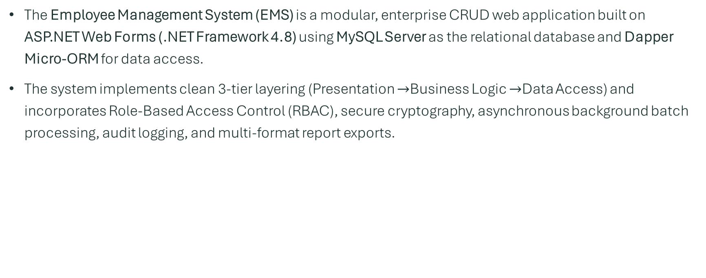
Introduction
The Employee Management System (EMS) is a modular, enterprise CRUD web application built on ASP.NET Web Forms (.NET Framework 4.8) using MySQL Server as the relational database and Dapper Micro-ORM for data access.
The system implements clean 3-tier layering (Presentation $→$Business Logic $→$Data Access) and incorporates Role-Based Access Control (RBAC), secure cryptography, asynchronous background batch processing, audit logging, and multi-format report exports.

Slide 3
Web Forms Page Lifecycle Integration
EMS leverages ASP.NET Web Forms lifecycle events to handle security, state persistence, and database interactions at exact execution phases:
  PreInit (Security Interception): BasePage.cs intercepts this stage before controls are initialized. It validates Session["UserRole"] and immediately redirects unauthenticated or unauthorized users.
  Init: Builds the control hierarchy; ViewState is not yet restored at this stage.
  Load (Page_Load): Checks if (!IsPostBack) to load initial data, execute Dapper read queries, and populate dropdowns or grid controls.
  Event (PostBack Events): Handles button clicks or RowCommand actions (e.g., executing CRUD operations via Dapper and recording audit entries).
  PreRender (RowDataBound): Applies dynamic UI rules and role-based control visibility (e.g., hiding Delete or Rollback buttons for non-Admin roles).
  Render: Generates HTML markup and streams it to the client browser.
  Unload: Disposes page and control resources. All database connections are already closed safely via using statements.

Slide 4
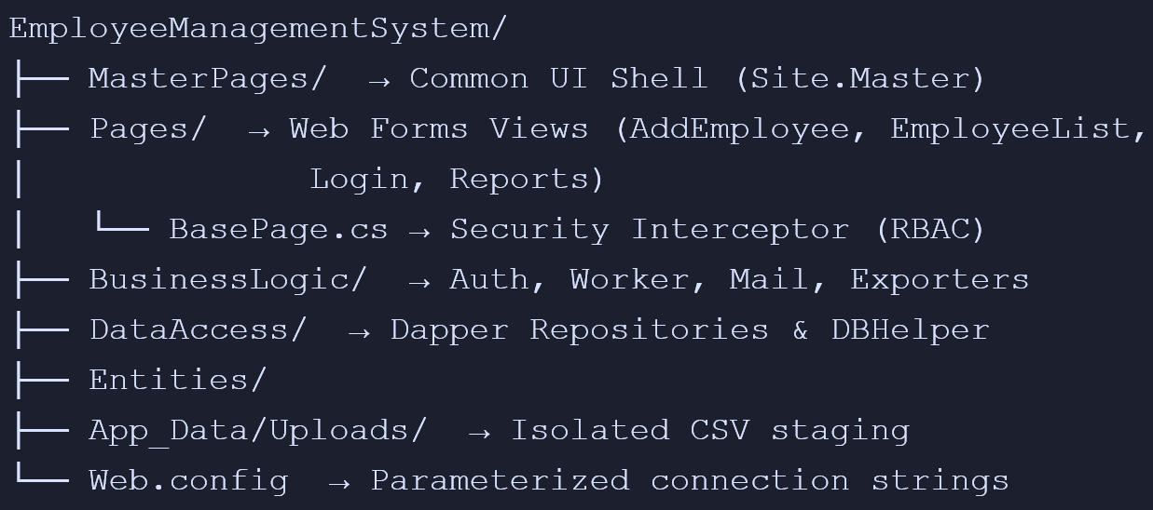
Project Folder Structure

Slide 5
Password Hashing & Security
Password security is managed in PasswordHelper.cs using industry-standard PBKDF2:
Salt Generation: Uses a unique cryptographically secure 32-byte salt per user.
Key Derivation: Applies 100,000 iterations of SHA-256 to derive the password hash.
Storage: Plaintext passwords are never stored, logged, or serialized.

Slide 6
Authentication, Login Flow & RBAC
How the Login Works:
  Credential Submission: The user submits their username/email and plaintext password via Login.aspx.
  Account Lockout Check: The system verifies if the account is currently locked. If 5 consecutive invalid attempts occur, the account is locked.
  Hash Verification: The user's stored salt is retrieved, and the provided password is authenticated using PBKDF2.
  Activity Logging: ActivityLogger.cs logs the login event, capturing the user's ID, timestamp, and client IP address.

Slide 7
Role-Based Access Control (RBAC)
Enforced at the architectural level via BasePage.cs on OnPreInit across three defined tiers:
Admin: Full CRUD capabilities, bulk uploads, soft rollbacks, and report generation.
HR: Create, view, bulk upload, and view reports (Delete and Rollback actions are hidden and disabled).
Employee: View-only access to the employee directory.

Slide 8
Database Connection & Data Access Layer
Architecture & Connection
  Factory Pattern (DBHelper.cs): Manages connection strings securely from Web.config and instantiates MySqlConnection instances.
  Connection Pooling & Safety: Connections are wrapped in using (var conn = DBHelper.GetConnection()) blocks to guarantee immediate socket closure and pool reclamation.

Slide 9
Query Execution (Dapper Micro-ORM)
SQL Injection Prevention: All queries use parameterized inputs (e.g., DynamicParameters).
Server-Side Pagination: Grid directory queries use LIMIT @PageSize OFFSET @Offset alongside a separate lightweight COUNT(1) query for total count calculation.
Soft Deletion: Deletion sets IsDeleted = 1 and updates UpdatedAt / UpdatedBy metadata rather than executing a hard SQL DELETE.

Slide 10
Import (Bulk Upload) & Export Architecture
Asynchronous Bulk Import
  Upload & Staging: In BulkEmployeeUpload.aspx, CSV file headers are validated, the file is saved to App_Data/Uploads/, a job is logged in the database (Status = 'Queued'), and an immediate response is returned to the user without blocking the web request.
  Background Processing: An in-process worker (BackgroundWorkerService.cs) running on a System.Threading.Timer polls for queued jobs.
  Transaction Batching: Records are processed row-by-row inside an explicit MySqlTransaction. If an individual row fails, it rolls back while logging errors, allowing valid rows to proceed.
  Soft Rollback: Admins can trigger a rollback for a specific JobId, which soft-deletes all employees associated with that batch import and logs the action.
Email Notification
  As valid employees are created during the batch upload, EmailService.cs asynchronously dispatches a welcome email from the background loop.
  Every dispatched notification is logged into an EmailLog database table for tracking and deliverability audits.
Multi-Format Exporting (ReportBuilder.aspx)
  CSV Export: Constructed dynamically using StringBuilder and streamed directly to Response.OutputStream as UTF-8 encoded bytes with the text/csv MIME header.
  PDF Export: Generates formatted tabular documents containing custom headers, timestamps, and page styling using iTextSharp, streamed with the application/pdf MIME type.

Slide 11
Styling & UI Implementation
Responsive Framework: Integrated with Bootstrap 5 for modern grid systems, form styling, and responsive navigation.
Unified UI Shell (Site.Master): Provides global stylesheets, header navigation, role indicator badges, and unified layouts across all .aspx views.
Server Controls: Form inputs use ASP.NET standard validation controls (RequiredFieldValidator, RegularExpressionValidator) styled with Bootstrap classes for unified client- and server-side validation.

